Slide 1
Developing and Marketing of a Submarine Sandwich
Alliance K-12
Winter Conference
January 30, 2014
Presented by
Jody houston, Director
Office of food services
Corpus christi isd

Slide 2
Corpus Christi, Texas
School Health Advisory Committee (SHAC) suggested Subway be contracted to prepare sandwiches for high school students

Slide 3
Response
Cost Consideration
Two submarine (sub) sandwiches developed in-house by the CCISD Office of Food Service’s Chef on staff
Tested
Sampled by students and adults who reported that they would be good additions to the menu

Slide 4
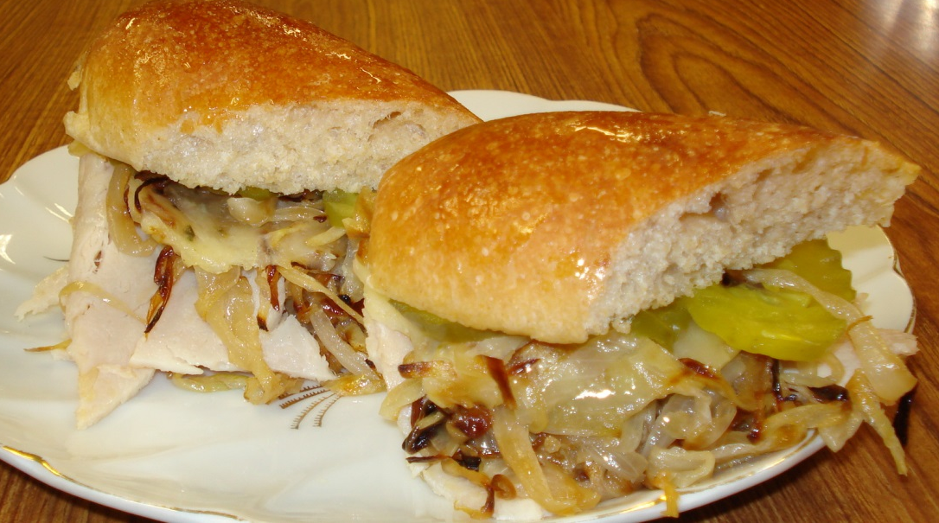
Development
‘The Little Havana Sub’
Sliced Turkey
Caramelized Onions
Pepper Jack Cheese
Honey Mustard
on a whole wheat bun
Served w/ sliced dill pickles on the side

Slide 5
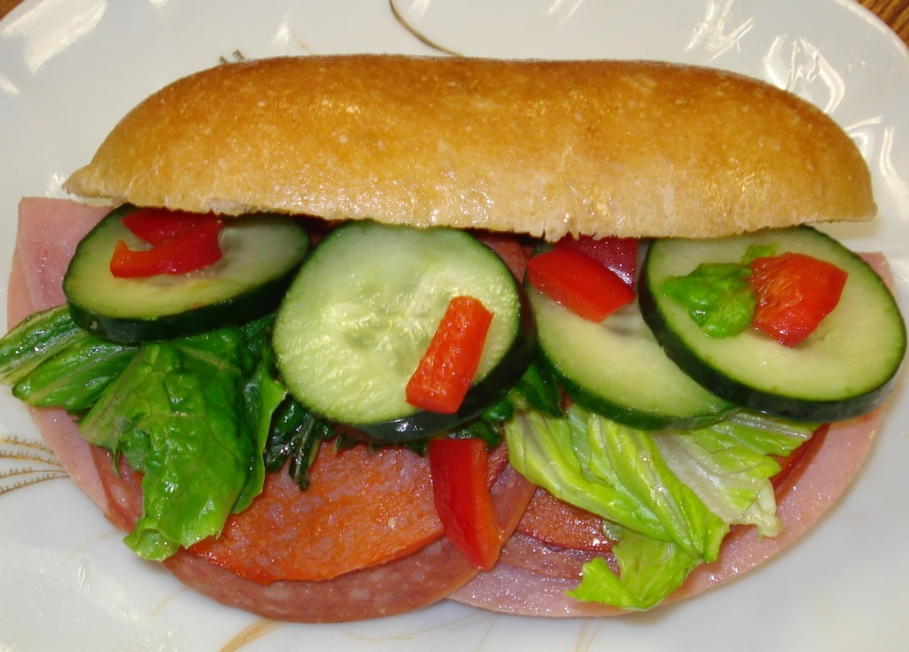
‘Not the BMT Sub’
Served on whole wheat bread
Ham, Pepperoni, & Salami
Topped with a special balsamic vinaigrette
(made with balsamic
vinegar, mustard,
Salad oil, honey,
salt & pepper)
Add lettuce and
tomato if desired

Slide 6
marketing
Texas A&M - Corpus Christi students recruited to create marketing plan for subs
Audience – High School Students
Goals
Encourage enjoyment of sub sandwiches during lunch
Encourage subs be taken as part of reimbursable meal

Slide 7
Marketing Activities
Brand sandwiches
Promote sandwiches in advance
Advertise sandwiches as they are being served
Publish nutritional information

Slide 8
Promotional Platforms
District’s website
Posters at schools or sporting events
School announcements
Signage in cafeteria
Social media
Activities at schools
During meal times
After/before school

Slide 9
Thank You

